Slide 1
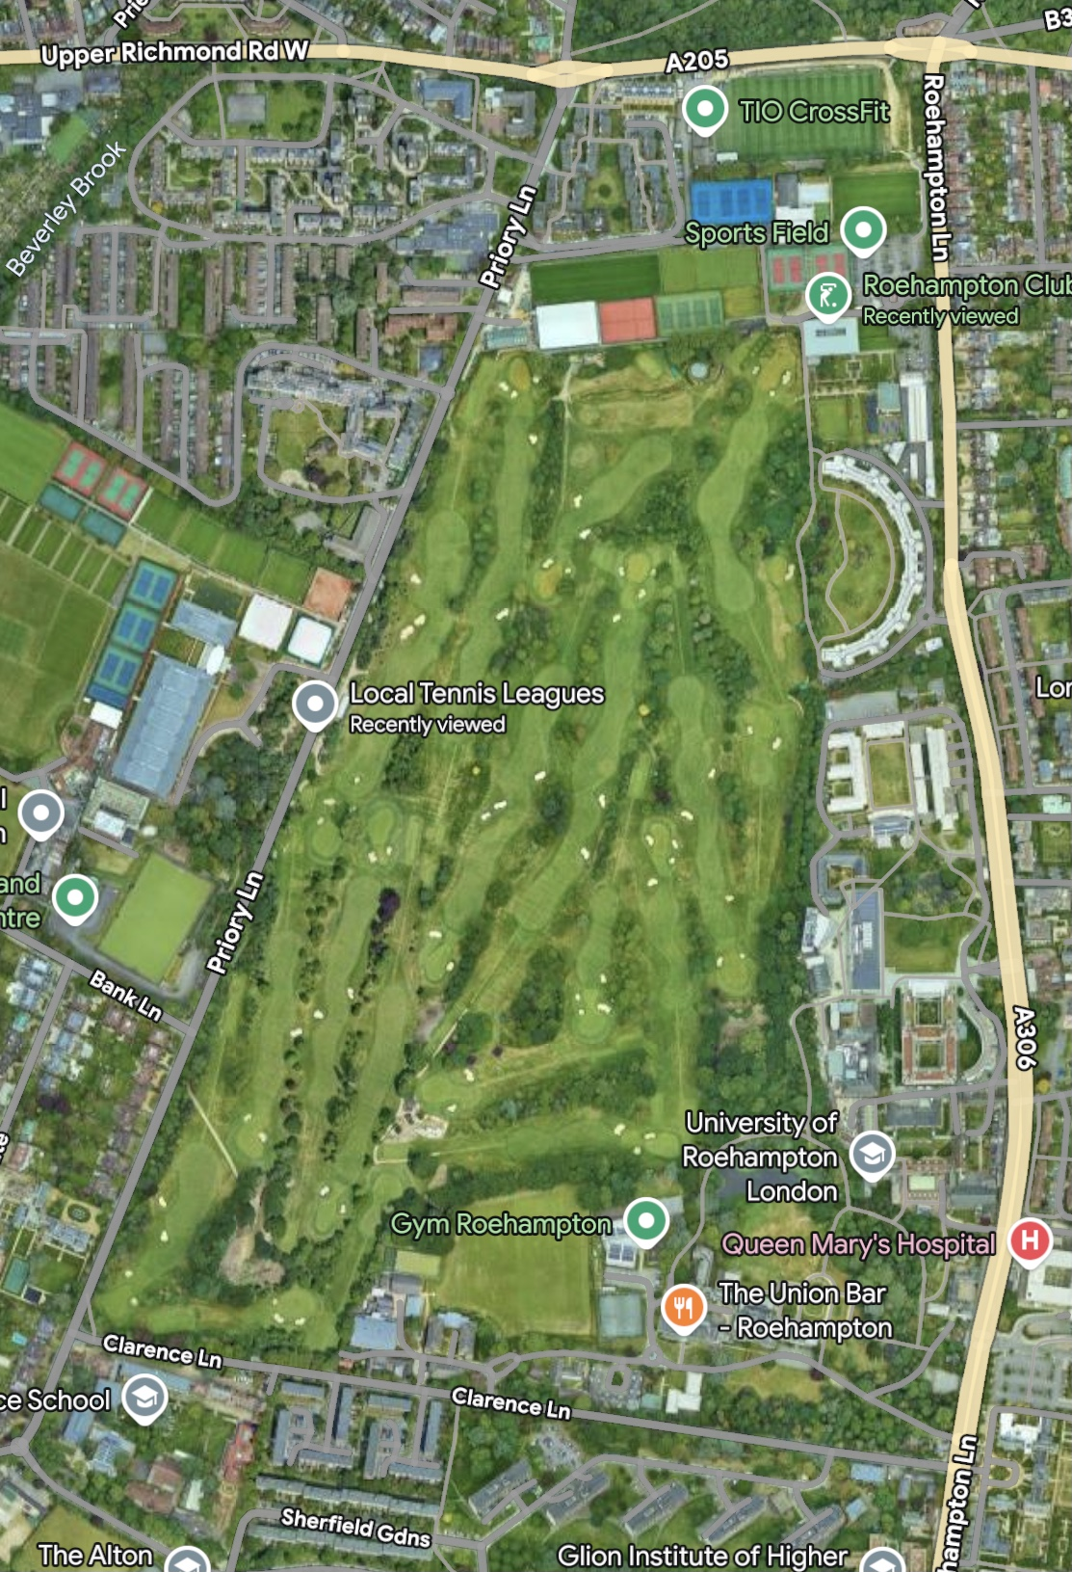
Roehampton Club overview
18 hole Golf Course
28 Tennis Courts
6 Squash Courts
2 Padel Courts
4 Croquet Lawns
Health Club with Gym and both Indoor and Outdoor Pools
Clubhouse with 2 Bars and Restaurants
Sports Injuries Clinic and Beauty Salon

Slide 2
What do we mean by Sustainability?
‘Sustainability in business refers to a company’s strategy and actions to reduce adverse environmental and social impacts resulting from business operations. REDUCE, REUSE, RECYCLE.’
Improving energy management efficiency by using alternative power sources and carbon accounting.
Deploying infrastructure that reduces greenhouse gas (GHG) emissions, preserves water resources and eliminates waste.
Operating dynamic and efficient supply chains to empower a circular economy, encourage reuse, design out waste, promote sustainable consumption and protect natural resources.
Enabling sustainable development by assessing risks and improving resiliency while adhering to external regulations and development goals.

Slide 3
How did we attack the problem?
Appointed Board Member to lead programme
Set up Environmental Committee to investigate areas of concern/improvement
Made initial assessment of current Carbon Footprint
Determined long term goals and agreed with Board
Looked for ‘quick wins’ and implemented them
Set up energy monitoring systems
Defined medium and longer term strategies
Assessed cost implications/payback timescales
Made budgetary provisions in Club Master Plan
Implemented pilot projects
Planned and rolled out main projects

Slide 4
What have we implemented so far?
Quick wins
Member Engagement
Reduction in plastics use
Food waste collection, composting and use as fertiliser on site
Water use reduction
Paper use reduction
Towel use policy
Outdoor pool cover and use policy
Food supplier policy
Completed LED lighting rollout
Implemented PIR controlled lighting
Implement solar pilot
Extend energy monitoring programme

Slide 5
What have we implemented so far?
Larger Projects
Install EV charging stations
Golf course drainage and water retention improvements
Solar arrays on all appropriate rooftops
Electrify all appliances in the kitchen
Electrify grounds machinery
Modify golf course bunkers to reduce maintenance and materials
Manage estate to increase biodiversity

Slide 6
Building development and renovations
Building Research Establishment Environmental Assessment Methodology - BREEAM
Ecology
Pollution
Waste
Energy
Management
Water consumption
Health and well being
Efficiency
Materials
Transport

Slide 7
What next?
Electrify, electrify, electrify!
Replace propane air handling unit in Indoor Tennis Centre
Replace diesel fuelled frost protection units on seasonal bubbles
Implement battery solutions
Install lightweight solar array on ITC roof
Install ASHP systems to heat pools in Health Club
Replace gas heating systems with ASHPs in Health Club and Clubhouse
Monitor and reduce consumption wherever possible.

Slide 8
What do we mean by Sustainability?
‘Sustainability in business refers to a company’s strategy and actions to reduce adverse environmental and social impacts resulting from business operations’
Improving energy management efficiency by using alternative power sources and carbon accounting.
Deploying infrastructure that reduces greenhouse gas (GHG) emissions, preserves water resources and eliminates waste.
Operating dynamic and efficient supply chains to empower a circular economy, encourage reuse, design out waste, promote sustainable consumption and protect natural resources.
Enabling sustainable development by assessing risks and improving resiliency while adhering to external regulations and development goals.

Slide 9
Any Questions

