Slide 1
Quality standards for padel and other key sports construction issues Richard Shaw Colin Corline
Notes:
Intro
Going to tell you a bit about SAPCA, some specifics about how we have interacted with padel before moving onto our evolving padel code of practice. In the break you can come and ask us about all the terrible things we have seen built that we can’t talk about up here!
Start with the personal before moving onto the professional. Easy to get lost in padel with noise objections, planning delays, wobbly instant padel courts that it’s a really fun game. View shifted by playing.
So first the sales pitch!

Slide 2
About SAPCA
We are the recognised trade association for the sports and play construction industry in the UK
Formed and owned by the industry in 1997 to be quality led
Non-profit making
Over 250 members from across the sport and play industry – including contractors, manufacturers, consultants, test houses etc.
Affiliate members including national governing bodies and sports councils.
Notes:
Trade Association and also quality badge. Mainly the latter that going to speak about today
Started in tennis, sure many of you know and can tell the SAPCA origin story far better than I! For those that don’t
Our members will cover -
Padel groundwork companies, aggregate suppliers, court manufacturers, court installers, consultants, canopy manufacturers, sand suppliers, artificial turf manufacturers, floodlighting designers contractors, net manufactures and maintenance companies
Owned by our members, for our members.

Slide 3
Aims
We promote high standards of design, construction and workmanship.
We liaise closely with the governing bodies of sport, both nationally and internationally to give our members a voice and promote dialogue with the industry.
We support members by providing information, advice, support and networking opportunities.

Slide 4
Focus on Quality
Our foundation was built on quality and that remains true today.
It is this quality that makes us a trusted partner of funders, governing bodies and commissioners.
Membership is based on demonstrating quality and being recognised as such by others within the industry.
Our Codes of Practice are used widely within the industry and by purchasers. We continually update these to ensure they represent the best current knowledge available.
These Codes also form the basis for our Quality System assessment of members which includes our inspection programme of members’ projects.
Members are asked to contribute to the quality programme to ensure that we are continually driving up standards within the industry.
We commission and take part in research for the knowledge and betterment of the industry.
We have a Mediation and Advisory Service for Complaints arising between members and their customers.
Notes:
Key to the start and continuance of SAPCA is a focus on quality
Virtuous circle

Slide 5
Membership Criteria
Able to demonstrate experience and reputation within the industry
Good financial standing
Project references and visits
Agree to Professional Code
Appropriate policies and insurances
Accepted by peers
Undergo continual assessment
Notes:
We aren’t easy to join and keep construction standards and professional standards high.

Slide 6
Padel & SAPCA
Supply greater than demand
Immature market
Membership rules
1 in 10 applications successful
Learning and evolving Code of Practice
Notes:
In my three years at the association seen growth
Demand hasn’t been filled by tennis court constructors as tennis market has filled their diaries, growth has been serviced by new companies often learning on the job. Not a criticism as I think all of Uk market has been learning and maturing.
We have been hampered in stepping into the void by our membership runs needing stability and longevity for example our insistence on a 3 year trading history meant that until recently even well established padel contractors within the UK market did not always meet this.
All of this has lead to a market that we don’t see in more mature markets such as tennis, football etc. plenty of example of bad practice. Lots of padel companies aim to join SAPCA but only 1 in 10 applications are successful for all the reasons listed
Flip side of the same coin is that it is an innovative, entrepreneurial market that both challenges SAPCA to continue to learn, and update its codes of Practice
Hand over to Colin

Slide 7
Codes of Practice
Minimum standard
Not a specification
Includes checklist
Promotes quality
Advises best practice

Slide 8
Padel in Numbers
2020
82 courts
2024
800 – 850 courts
2023
350 – 400 courts
2025
?

Slide 9
Padel Code of Practice
Edition 1 – 2020/21
LTA Guidance Note
Pandemic
SAPCA CoP essential
Edition 3 - 2024
Focus on site specific designs
Noise!
UK weather
Edition 2 - 2023
Better planning guidance
Increase in covered courts
Non-traditional contractors
Edition 4 - 2025
Suitable structures for UK
Enhanced materials spec
Further planning guidance

Slide 10
Padel Code of Practice
Minimum standard for SAPCA
LTA support
Nothing else in the marketplace
Reviewed alongside market trends
Notes:
Run through

Slide 11
Key focus in 2020 / 2021
Ensure a fit for purpose guidance document was developed
Site specific foundation design
Suitability of Padel Enclosures in UK climate
General guidance to an immature market

Slide 12
Key focus now – Enhanced document
Increased covered court information
Foundation, foundation, foundation!
Key learnings from 5 years
Continued education of the market

Slide 13
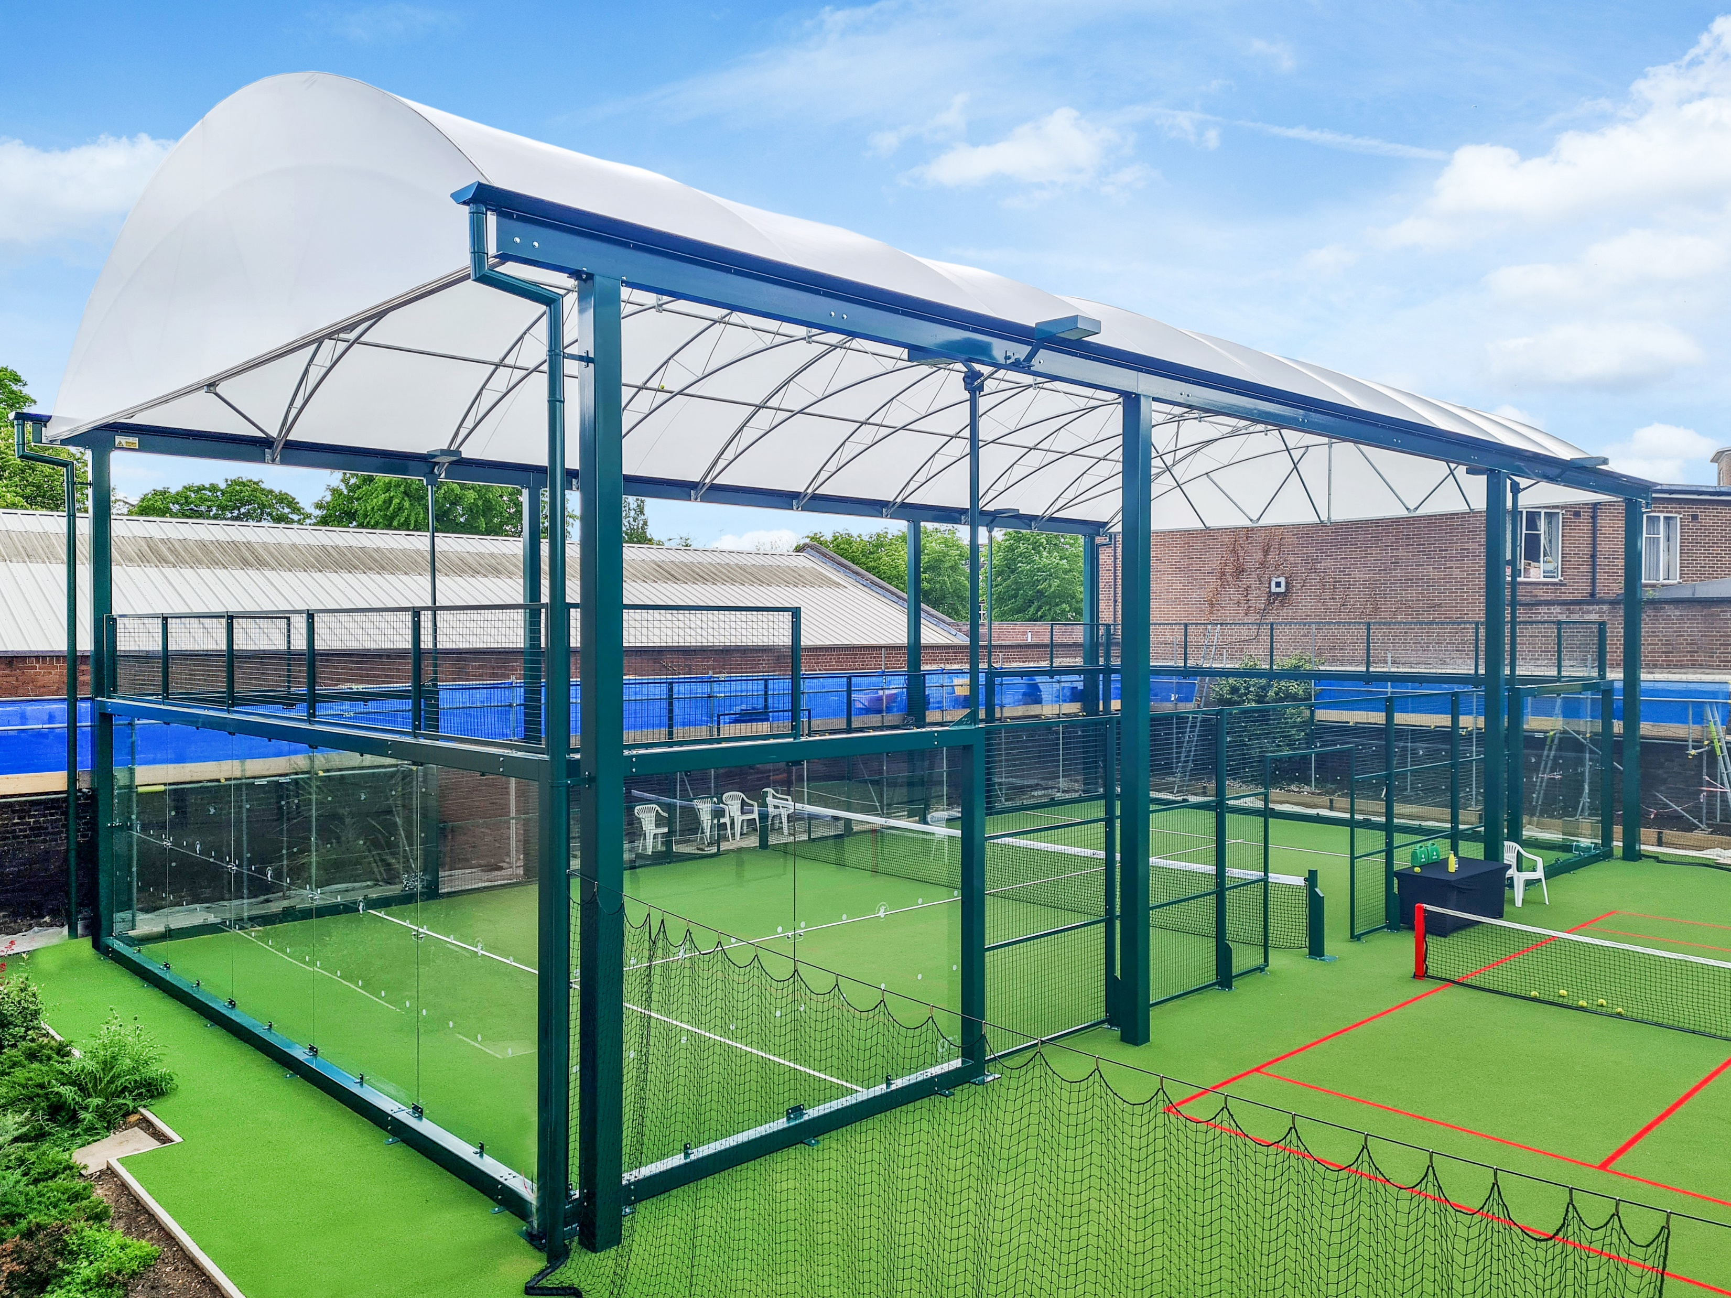
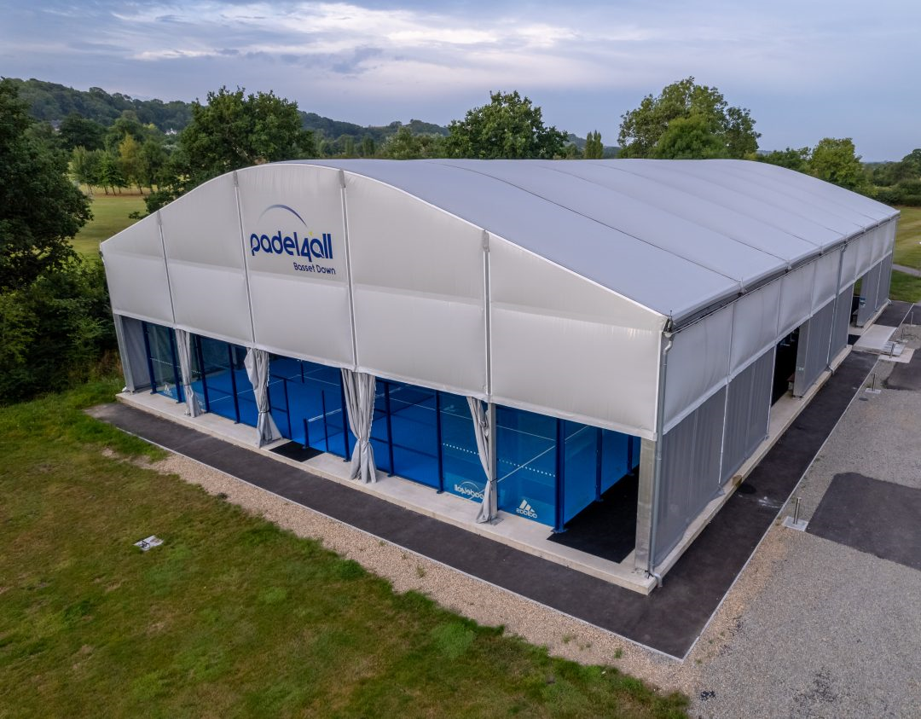
Structure Types
Modular;
Integrated design with padel courts
Cost effective solution
Additional sections can be added in future
Typically lower in overall height
Clear Span;
Covers multiple courts with one single structure
Curve of roof typically follows flight of the ball.
Ensures maximum height over entirety of the net
No stanchions required between courts
Notes:
Explain

Slide 14
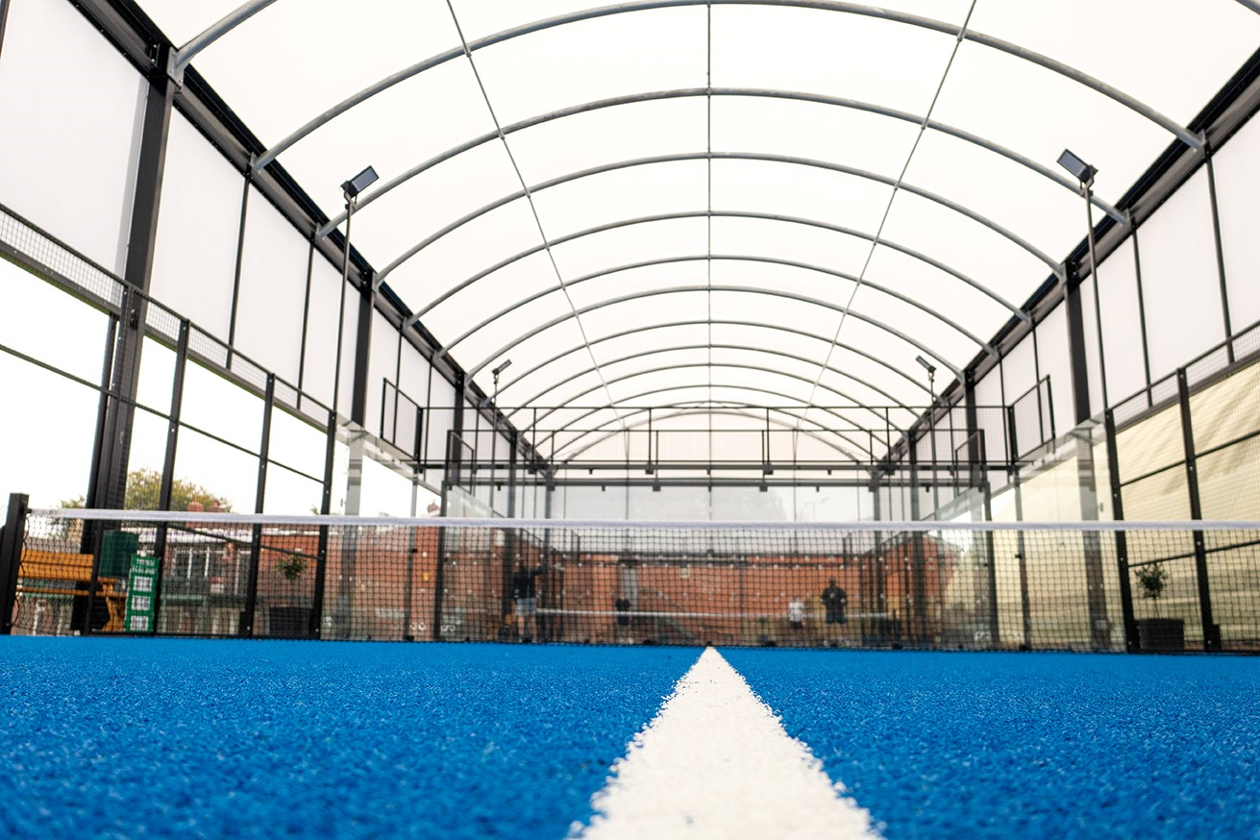
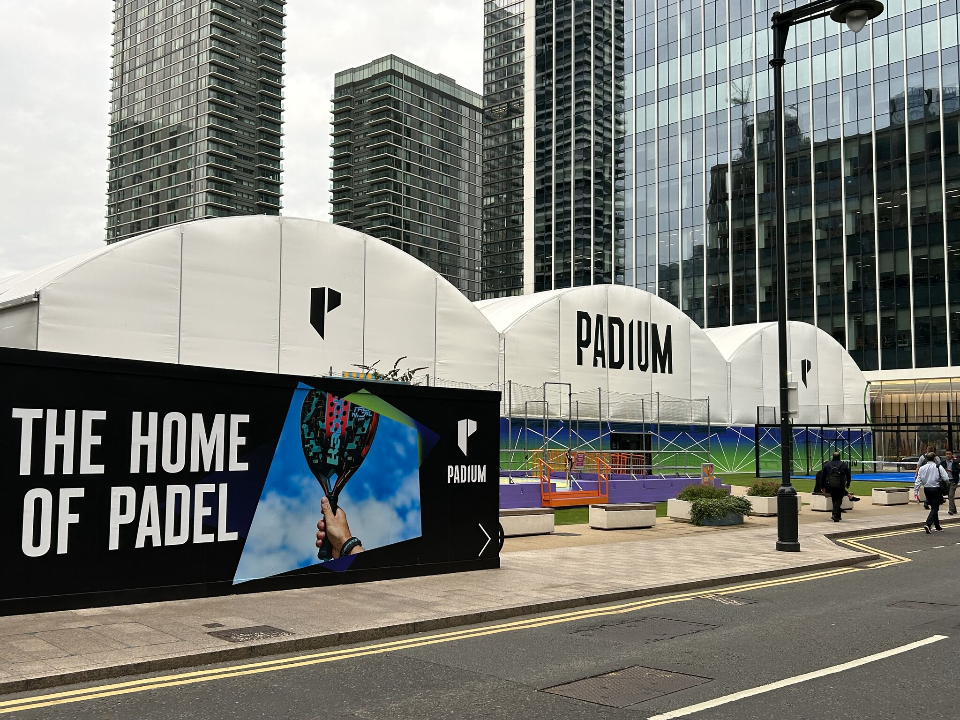
Design Criteria
Site specific structural calculations
Nominated engineer to hold PI
Calculations include below ground requirement
Conform to UK Building regulations
Lighting can be fixed to structure
Emergency lighting required for retractable or permanent sides (subject to building control requirements)
Planning Approval
Building Control Sign Off
Notes:
Follows the technical notes within the CoP
Apply to either modular or clearspan

Slide 15
Key UK sports construction considerations
Weather and climate change
Planning approval challenges
Drainage requirements
Construction in floodplain areas
Ecology
Bio-diversity net gain
Noise

Slide 16
UK Weather
Excessive rainfall and getting worse
Wind loading variations across UK
Padel in coastal locations

Slide 17
Coastal locations

Slide 18
Drainage requirements
Planners not understanding the way sports facilities drain
Requirements for SuDS
Use of sports facilities as water attenuation
Protection of the surrounding area

Slide 19
Construction in floodplains

Slide 20
Bio-diversity Net Gain
Biodiversity net gain (BNG) is a way of creating and improving natural habitats. BNG makes sure development has a measurably positive impact (‘net gain’) on biodiversity, compared to what was there before development.
In England, BNG is mandatory under Schedule 7A of the Town and Country Planning Act 1990 (as inserted by Schedule 14 of the Environment Act 2021).
Developers must deliver a BNG of 10%. This means a development will result in more or better-quality natural habitat than there was before development.

Slide 21
Noise
Very relevant to Padel!
Essential Noise reports
May require post construction assessments
Environmental health issues

Slide 22
Top Tips
If its cheap, there is a reason
Use SAPCA members
Groundworks are important
Investigate design options
Maintenance is essential

Slide 23
Thank you!
www.spaca.org.uk
Notes:
Lots more resources on website including full codes of practice.

