Slide 1

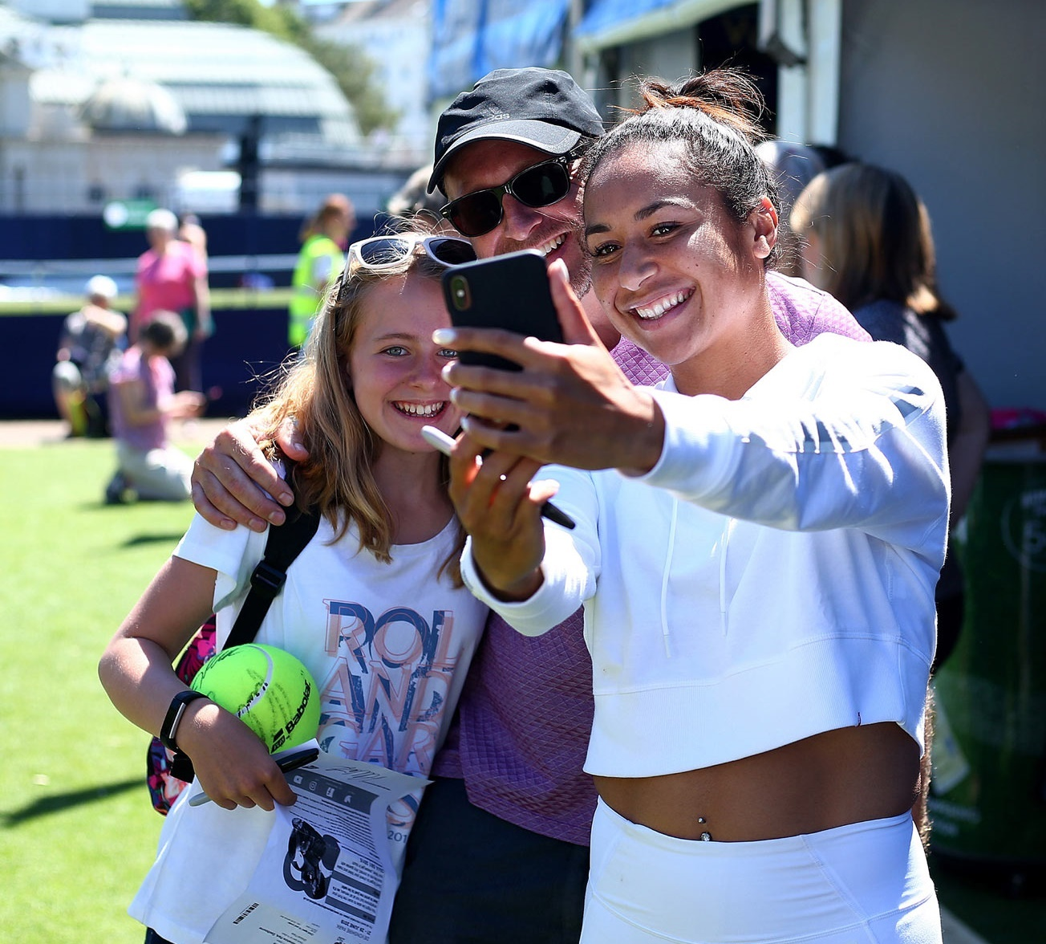


TIA – Parks Tennis The New landscape

Slide 2
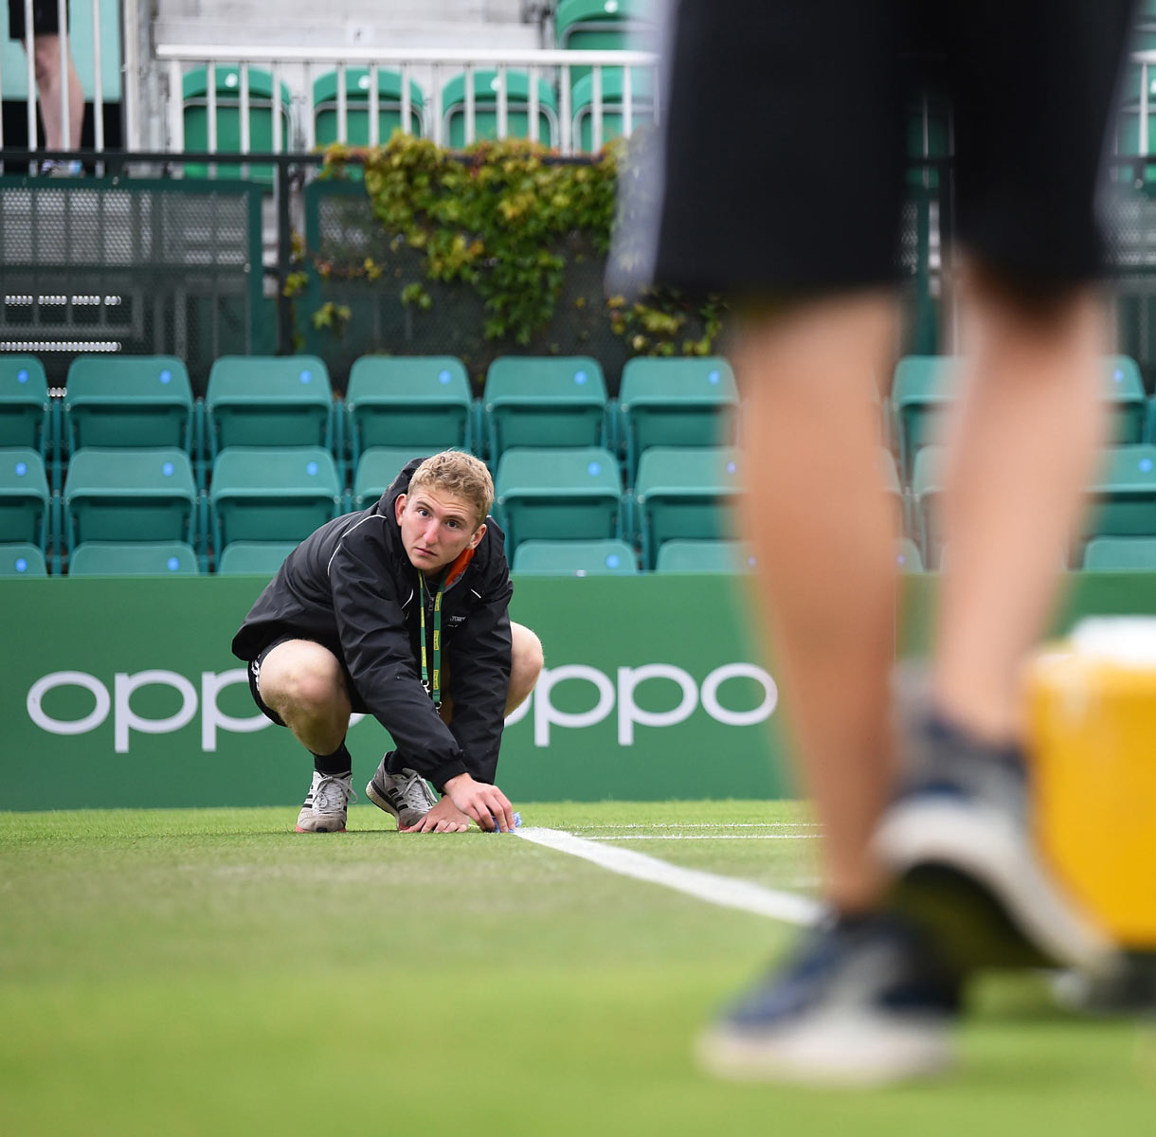

Contents
Who Plays Tennis in Parks?
Parks Renovation Project Overview
Operational Models of Parks
How Park Operators win contracts
How does the LTA support post renovation
Case Study – Richmond-Upon-Thames
Questions

Slide 3
Who plays tennis in parks?
Profile of past year adult tennis players by gender, age and social grade (Sept 23 – Aug 24)
Compared to tennis club players, adults who play on park courts are more likely to be female and mid-aged, and less likely to come from the affluent AB social grade

Slide 4
Park players are much more likely than club players to consider themselves beginners or improvers
Current Standard of Play (Sept 23 – Aug 24)
Source: Basline Tracker Sept 23 – Aug 24, all playing tennis in past 12 months
Which of the following best describes your standard of tennis play?

Slide 5
Most park players only play socially / informally – with family tennis relatively more important to them than club players
Types of Tennis Played
And which of these types of tennis have you played in the last 12 months
Sept 23 – Aug 24

Slide 6
For those who play in parks, the ability to socialise / play with people they know (friends and family) are more important motivators for increased play compared to club players.
Factors that would encourage more frequent tennis play
Past 12 month players: Sep 22 – Aug 24
Which of these would be important in helping you to take up tennis or play more often? Please tick all that apply?
All using that venue in P12M: Sep 22 – Aug 24
Park players – 1320, club players -823

Slide 7


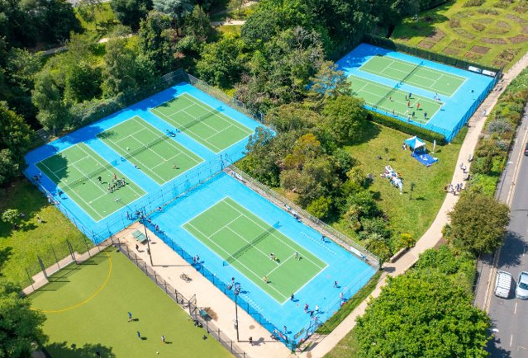

What does a good park look like?
Good quality Court Facilities
Easy to find & Book
Opportunities to try the sport
Good ancillary facilities*
Opportunities to get coaching
Financially sustainable
Chance to meet people
Social Competition
*where possible

Slide 8
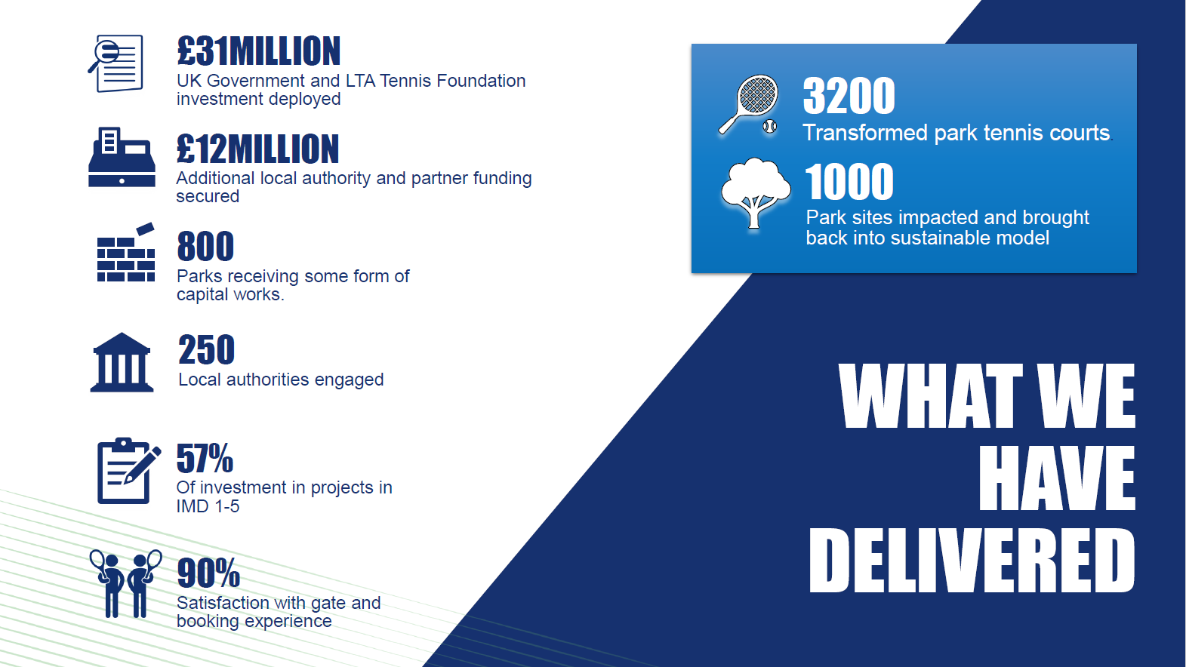

Slide 9




The Digital Journey to Tennis!
Web Based – and now App based!
Book a court in as little as four clicks.
Use FaceID to login smoothly
ApplePay and Google Pay. make checkout seemless.
Find a player by joining your local community.
Quick link to recently booked venues for ease in re-booking.
Quick link to nearby venues

Slide 10
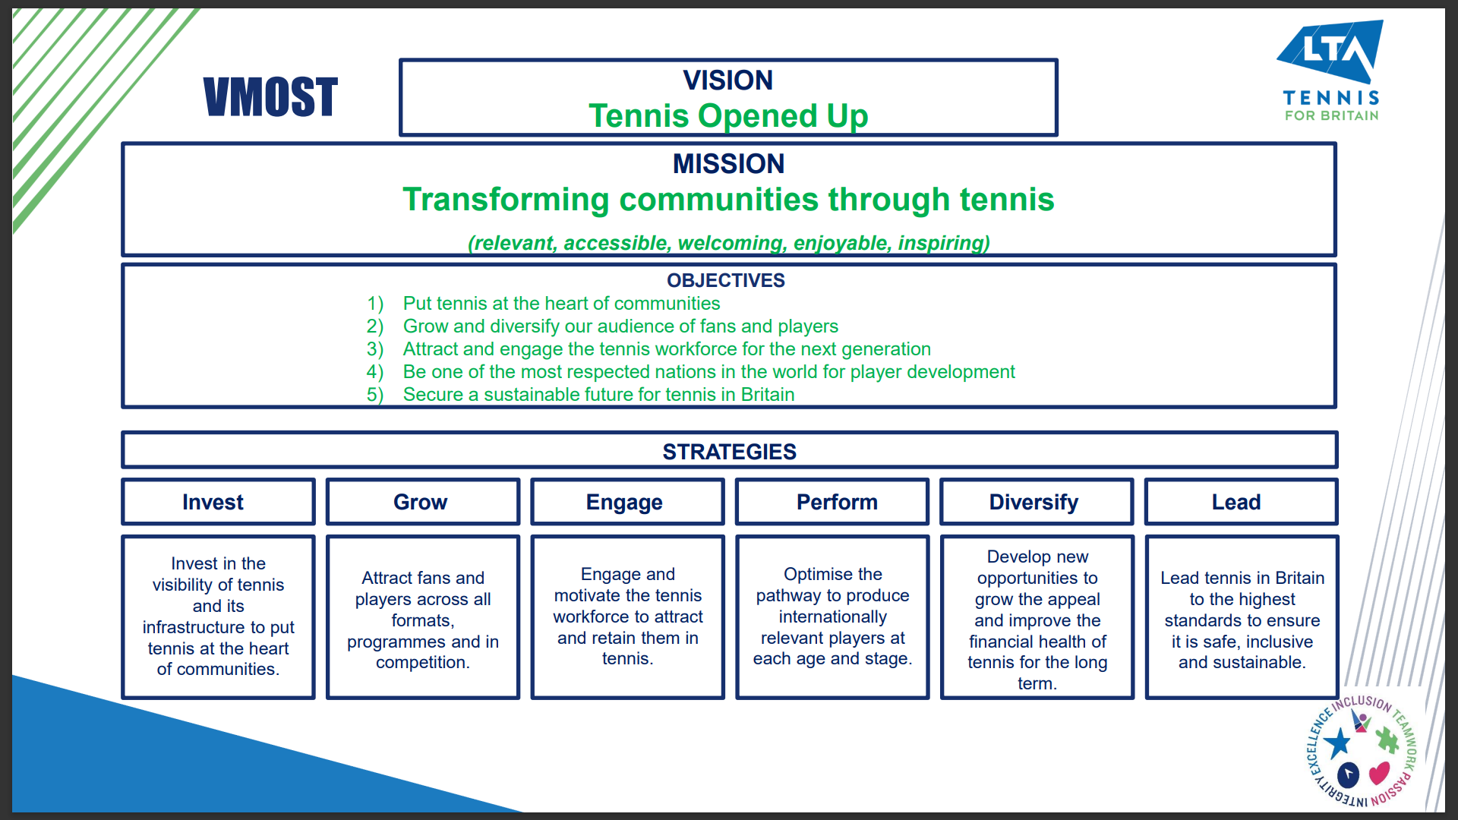

Slide 11

Operational models
THREE clear models In use;
MODEL 1
14%
MODEL 2
35%
MODEL 3
51%
Full Operation Outsourced
IN HOUSE
IN HOUSE
Leisure Operator
Tennis Operator
Club
CIC / Active P’ship
Coaching Tendered out to tennis provider
Coaching Tendered out to tennis provider
Coaching Tendered out to tennis provider

Slide 12


Financials in Parks
Income Opportunities:
Pay & Play Court Bookings – free hours, £4 +
Season Passes - £40, different offerings
Coaching Programmes
Competitions
Ancillary Facilities (café etc)
Expenses:
Sinking Fund - £1200 / £1800 per court per year
Ongoing cleaning costs
Court Cleaning

Slide 13


Winning Contracts
In most cases these have to be publicly advertised
Most councils and public bodies have dedicated procurement or “Doing Business with Us” pages.
Local Authority Portals
Local publications – occasionally used in smaller areas
Often include 2 areas of application – Financials and Impact
Contracts vary in length – many opportunities ongoing
Most councils and public bodies have dedicated procurement or “Doing Business with Us” pages.

Slide 14








Marketing
The LTA run campaigns that helps to boost interest in tennis, which links to opportunities to play in your parks
Governance
We help Operators run legally and efficiently with external support available for registered venues
LTA Support
How does the LTA Support Local Authorities and Operators to achieve shared goals?
LTA Product Delivery
We have multiple products and programmes that boost participation that can be adopted by Operators
Operational Guidance
We help Operators to operate in the best way for them, providing reporting and insight to evidence what is working well
Sharing Ideas
We bring together Local Authorities and Operators to learn, share best practise and provide updates
Digital
The LTA booking site increases the number of people playing at your sites, whilst other digital platforms help run your businesses.

Slide 15
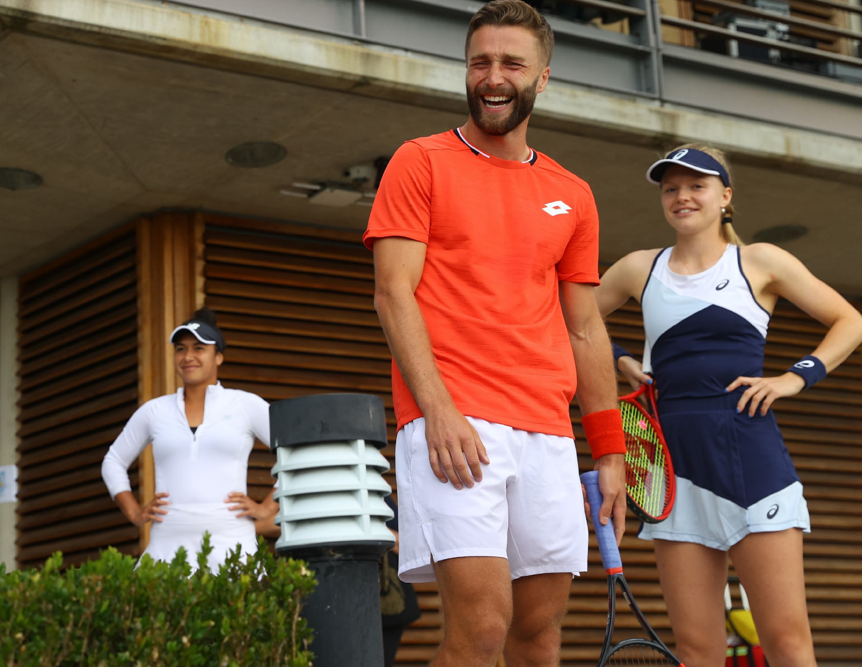
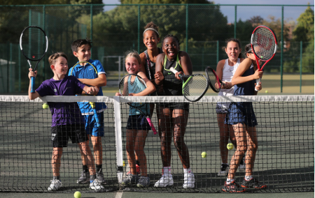

Case Study?
Richmond – Upon – Thames
lta-parks-success-story-richmond.pdf

Slide 16

Video and Questions
LTA on X: ""Dear Andy, this is where it all began..." @andy_murray's love letter to local courts in celebration of the transformation of over 3,000 park tennis courts across Britain ❤️ https://t.co/lFNAUg679O" / X

